Slide 1
E-Retail factors for customer activation and retention: A case study from Indian e-commerce customers
Project Report By :
Satarupa Goswami

Slide 2
Introduction :
Online shopping is a form of e-commerce which provides customers, the ability to browse and buy huge range of goods and services from sellers over the internet using different web browsers or mobile applications. Online shopping is related to life styles now a days.
Now, we all know there are so many websites or mobile applications are ongoing, but according to the customers, all of the online shops are not capable of providing great deals or services all the times. And for that customer churn happens.

Slide 3
Problem statement :
Customer satisfaction is most important thing in E-retail sectors which has the ability to drive the growth of the online retailers influencing in retaining and stimulating purchases and repurchases it is of utmost importance to explore what are the factors that drives the customers.
Five major factors that contributed to the success of an e-commerce store have been identified as: service quality, system quality, information quality, trust and net benefit.
The combination of both utilitarian value and hedonistic values are needed to affect the repeat purchase intention (loyalty) positively. The data is collected from the Indian online shoppers.

Slide 4
About the dataset :
The dataset is containing 269 rows and 71 columns.
The dataset is good blend of categorical and nominal data.
The 71 columns are actually different types of questions those have been asked to the customers to understand their point of view and their experience regarding various e-commerce retail sectors.

Slide 5





Tools used
pandas
NumPy
seaborn
matplotlib.pyplot
scikit-learn

Slide 6
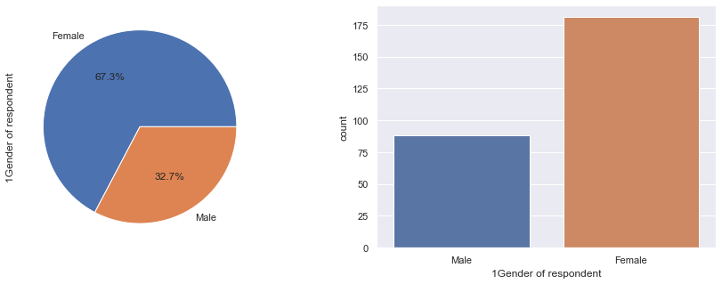
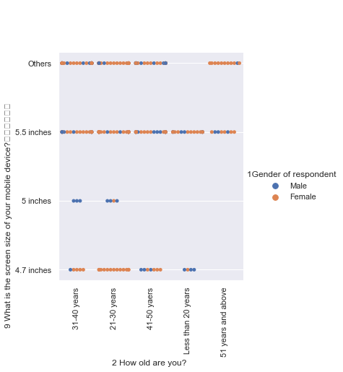
Exploratory Data Analysis:
Female individuals are more into online shopping than male individuals.
Female individuals from any age group are more into
online shopping than male individuals.

Slide 7
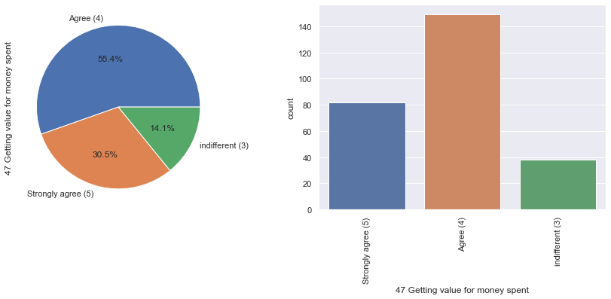
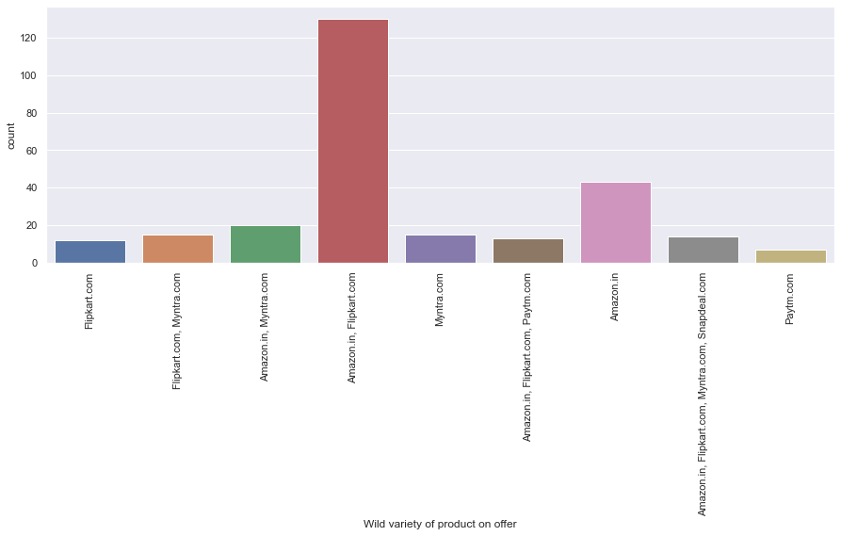
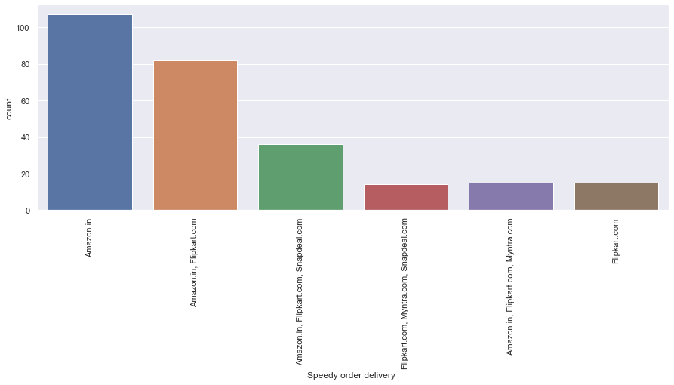
Service quality :
1. Value for money is important.
2. Wild quality of products by Amazon & Flipkart.
3. Amazon.in delivers the quickest.

Slide 8
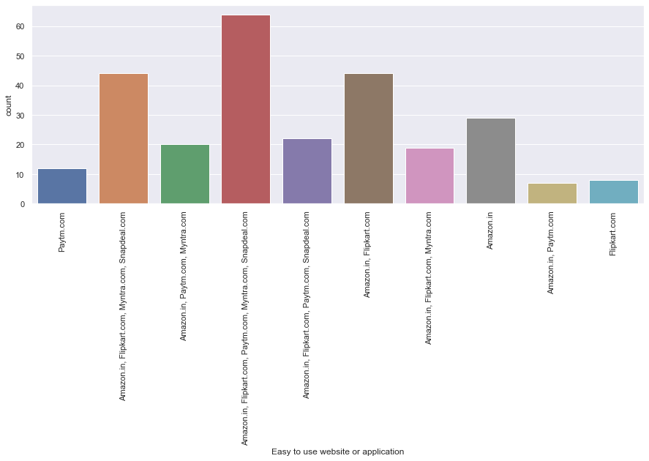
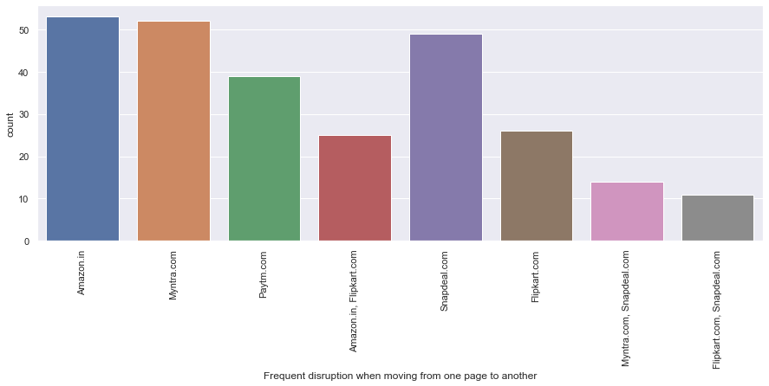
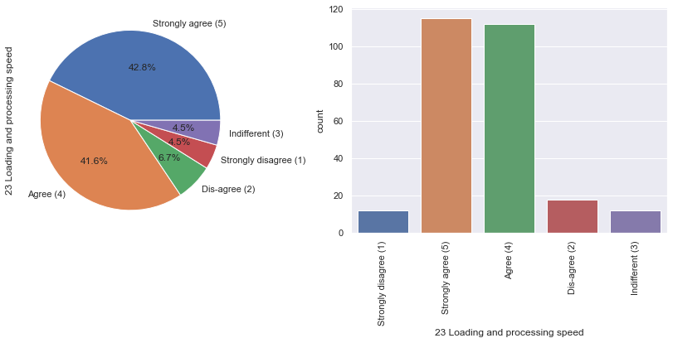
System Quality:
1. Amazon.in, Flipkart.com, Paytm.com, Myntra.com, Snapdeal.com are easy to use.
2. The frequency of disruption while moving from one page to another is highest in Amazon.in .
3. Loading and processing speed is important.

Slide 9
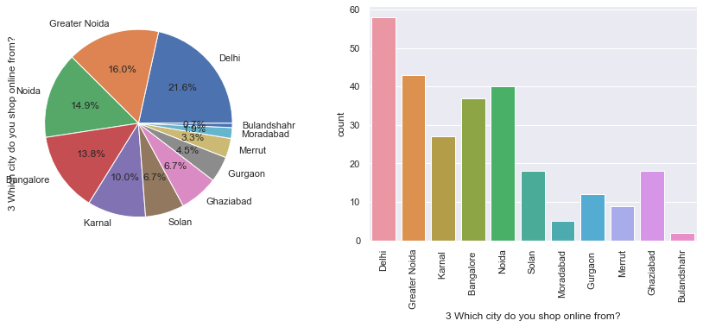
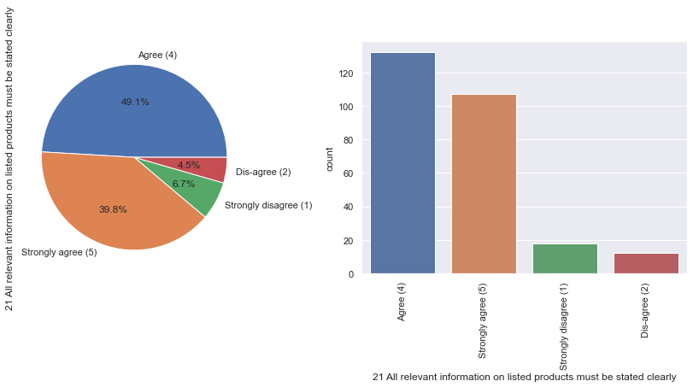
Information quality:
People of Delhi mostly do online shopping than rest of the other cities.
Highest count of people are agreed(4) to all relevant information on listed products must be stated clearly.

Slide 10
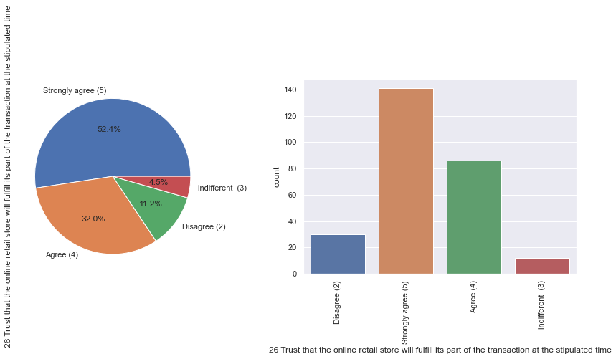
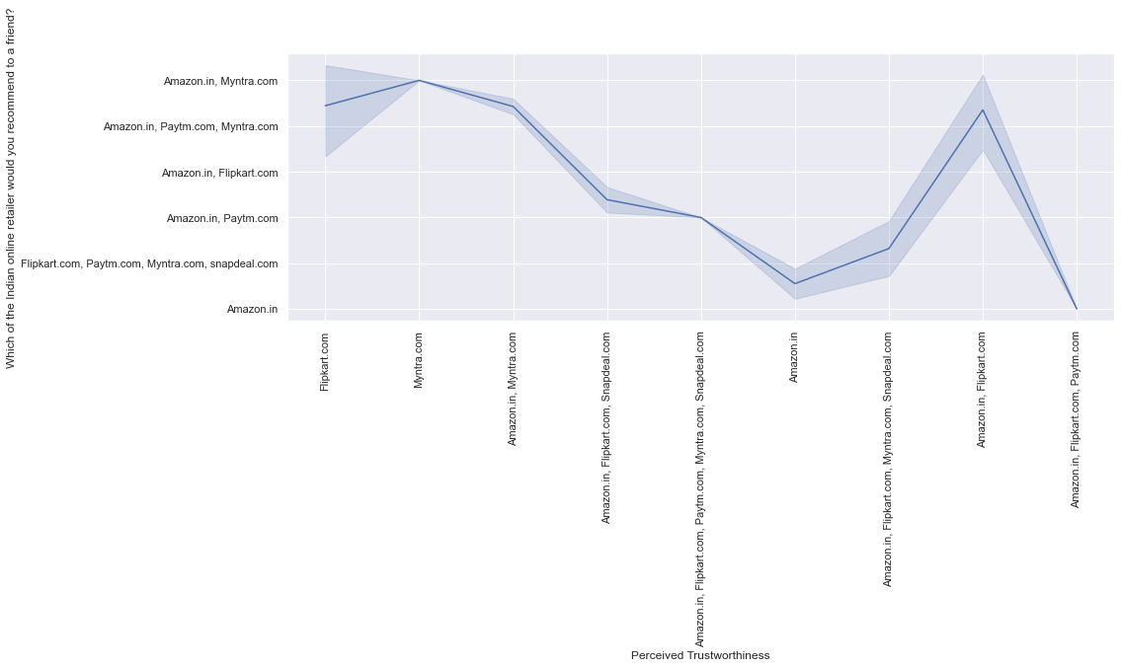
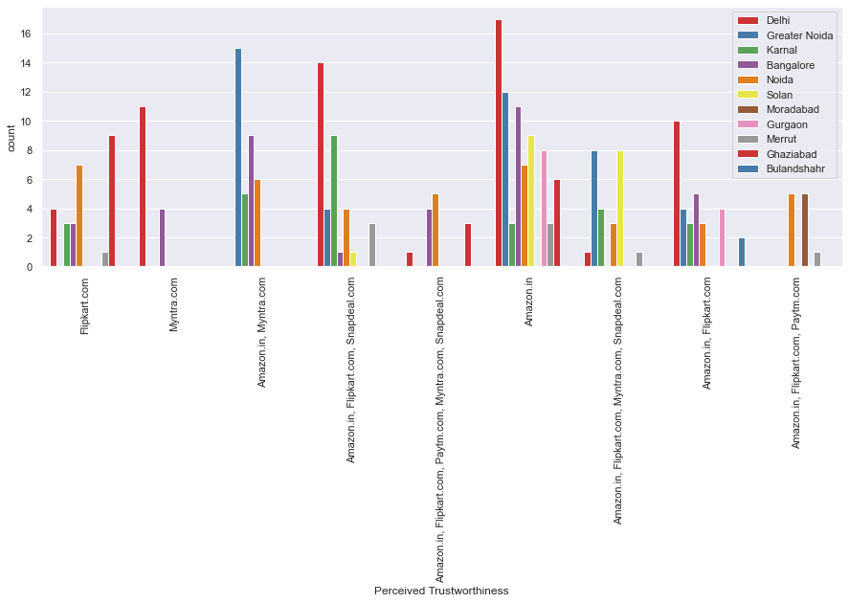
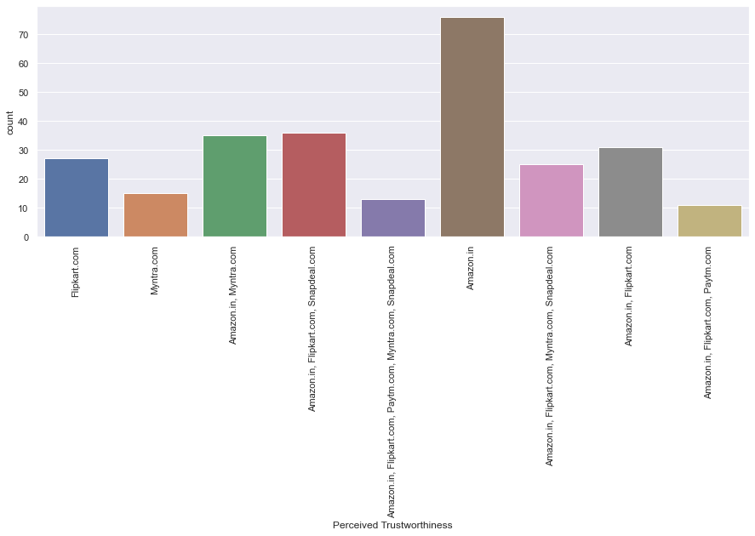
Trust:
1. People are Strongly agreed(5) that there is trust that the online retail store will fulfill its part of the transaction at the stipulated time.
2. People from Delhi think Amazon.in perceived trustworthiness.

Slide 11
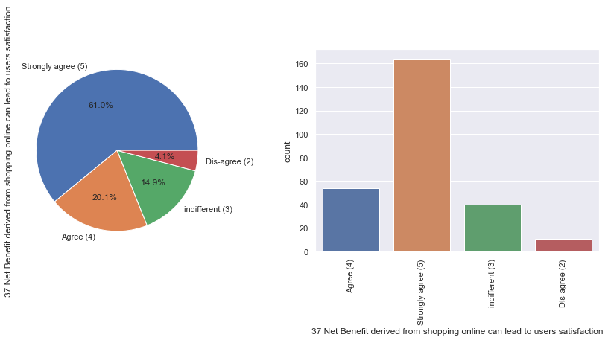
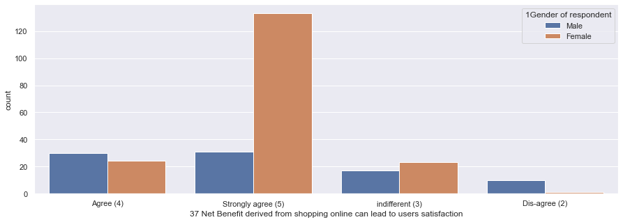
Net benefit in terms of value added:
1. Highest count of people are Strongly agreed(5) that Net Benefit derived from shopping online can lead to users satisfaction.
2. Highest count of female individuals are strongly agreed that Net benefit derived from shopping online can lead to users satisfaction.

Slide 12





Conclusion:
The most preferred website/application is Amazon.in .
The most involved gender, regarding online shopping is Female.
To retain customers, websites should fix their bugs as sometimes during sale the applications get lagged.
Customers show more trust towards Amazon.in.
Customers also feel a sense of value while shopping from Amazon.in.
The e-retailers should maintain their quality as people are always looking for better options. The analysis also goes on to show gender based inclination towards e-retail sectors. The dataset is particularly interesting as it showcases area based shopping experiences which is a clear reflection of growing digital India.

Slide 13

Thank you for your attention!
Any Question or query?
Contact Information :
Email : goswamisatarupa92@gmail.com

